Slide 1

Noida Institute of Engineering and Technology, Gr. Noida
Theory of Automata and Formal Languages
(ACSE0404)
Unit: IV
Push Down Automata
B. Tech
(Computer Science & Engineering)
4th Semester
GARIMA JAIN
Department of Data Science & CSBS

Slide 2


Brief Introduction of Instructor
Ms. Garima Jainis working as an Assistant Professor in the Department of School of Computer Science and Emerging Tehnology.
She is M.Tech in Computer Science and Engineering from Galgotias College of Engineering and Technology, Greater Noida.
He has 5 Years of experience in Industry and Academia.
His area of Interest includes Operating System, Data Design and Analysis, Algorithms, Theory of computation and Machine Learning.

Slide 3
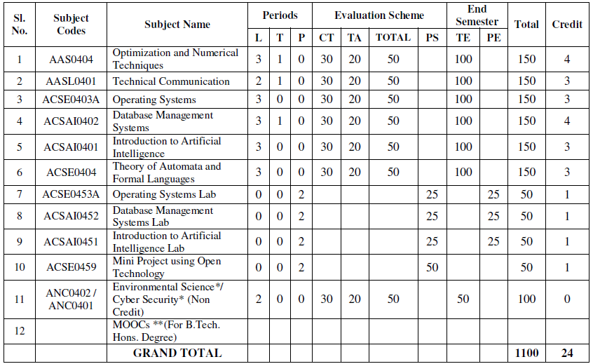
Evaluation Scheme

Slide 4

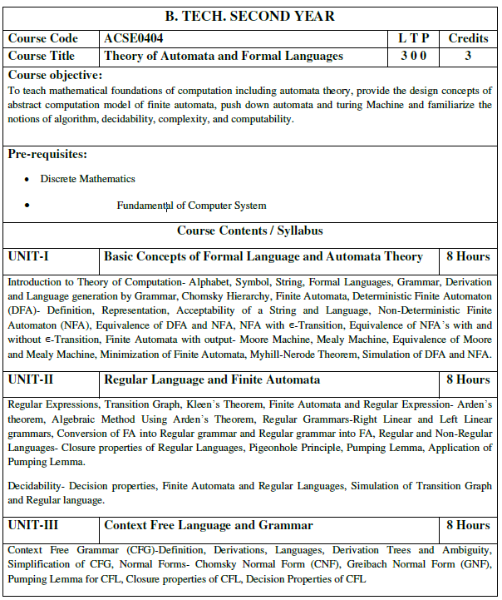
Subject Syllabus

Slide 5
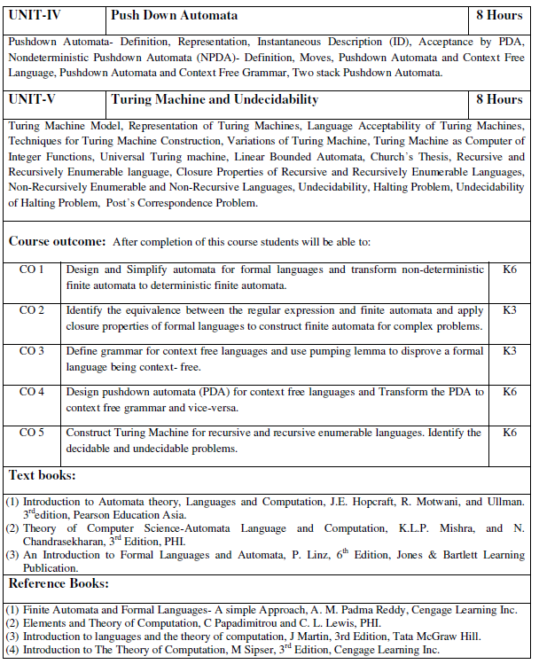
Subject Syllabus

Slide 6
Links
Unit I https://nptel.ac.in/courses/106/104/106104028/Lecture 1 -10, Lecture 16, 17 18, 19 https://nptel.ac.in/courses/113/11111/1003016/ https://www.youtube.com/results?search_query=%23AutomataTheory Unit II https://nptel.ac.in/courses/106/104/106104028/Lecture 11 -15 https://nptel.ac.in/courses/113/11111/1003016/ https://www.youtube.com/results?search_query=%23AutomataTheory Unit III https://nptel.ac.in/courses/106/104/106104028/Lecture 20 -30 https://nptel.ac.in/courses/106/106/106106049/ https://www.youtube.com/results?search_query=%23AutomataTheory Unit IV https://nptel.ac.in/courses/106/104/106104028/Lecture 31 -33 https://nptel.ac.in/courses/113/11111/1003016/ https://www.youtube.com/results?search_query=%23AutomataTheory Unit V https://nptel.ac.in/courses/106/104/106104028/Lecture 34-42 https://nptel.ac.in/courses/113/11111/1003016/ https://www.youtube.com/results?search_query=%23AutomataTheory
LINKS

Slide 7
Branch Wise Applications
It can compute man-made problems as well as natural phenomena.
Automata theory has a lot of applications in real life as well, such that: Lambda calculus, Combinatory logic, Markov algorithm, and Register, Natural Language Processing ,Compiler Design and Lexical analysis and Semantic analysis. Also, the concept of Formal languages and automata theory can overlap with other subjects as well.

Slide 8
Course Objective
Introduce concepts in automata theory and theory of computation
Identify different formal language classes and their relationships and PDAs.
Applying the Concept of Turing Machine and LBAs.
Prove or disprove theorems in automata theory using its properties
Determine the decidability and intractability of computational problems and complexity theory.

Slide 9
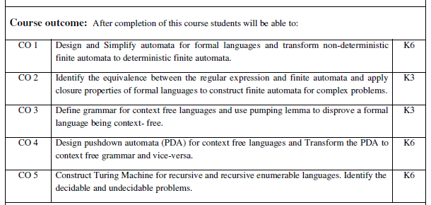
Course Outcome

Slide 10
Program Outcomes (POs)
Engineering Graduates will be able to:
1. Engineering knowledge: Apply the knowledge of mathematics, science, engineering fundamentals, and an engineering specialization to the solution of complex engineering problems.
2. Problem analysis: Identify, formulate, review research literature, and analyze complex engineering problems reaching substantiated conclusions using first principles of mathematics, natural sciences, and engineering sciences.
3. Design/development of solutions: Design solutions for complex engineering problems and design system components or processes that meet the specified needs with appropriate consideration for the public health and safety, and the cultural, societal, and environmental considerations.
4. Conduct investigations of complex problems: Use research-based knowledge and research methods including design of experiments, analysis and interpretation of data, and synthesis of the information to provide valid conclusions.

Slide 11
Program Outcomes (POs)
Contd..
5. Modern tool usage: Create, select, and apply appropriate techniques, resources, and modern engineering and IT tools including prediction and modeling to complex engineering activities with an understanding of the limitations.
6. The engineer and society: Apply reasoning informed by the contextual knowledge to assess societal, health, safety, legal and cultural issues and the consequent responsibilities relevant to the professional engineering practice.
7. Environment and sustainability: Understand the impact of the professional engineering solutions in societal and environmental contexts, and demonstrate the knowledge of, and need for sustainable development.
8. Ethics: Apply ethical principles and commit to professional ethics and responsibilities and norms of the engineering practice.

Slide 12
Program Outcomes (POs)
Contd..
9. Individual and team work: Function effectively as an individual, and as a member or leader in diverse teams, and in multidisciplinary settings.
10. Communication: Communicate effectively on complex engineering activities with the engineering community and with society at large, such as, being able to comprehend and write effective reports and design documentation, make effective presentations, and give and receive clear instructions.
11. Project management and finance: Demonstrate knowledge and understanding of the engineering and management principles and apply these to one’s own work, as a member and leader in a team, to manage projects and in multidisciplinary environments.
12. Life-long learning: Recognize the need for, and have the preparation and ability to engage in independent and life-long learning in the broadest context of technological change.

Slide 13
CO-PO correlation matrix
CO-PSO mapping are yet to be finalized for Emerging branches.

Slide 14
Program Specific Outcomes
PSOs are yet to be finalized for Emerging branches.

Slide 15
CO-PSO correlation matrix
CO-PSO mapping are yet to be finalized for Emerging branches.

Slide 16
Program Educational Objectives (PEOs)
PEOs are yet to be finalized for Emerging branches.

Slide 17
Result Analysis
Not Applicable.

Slide 18
CO-PSO correlation matrix
CO-PSO mapping are yet to be finalized for Emerging branches.

Slide 19
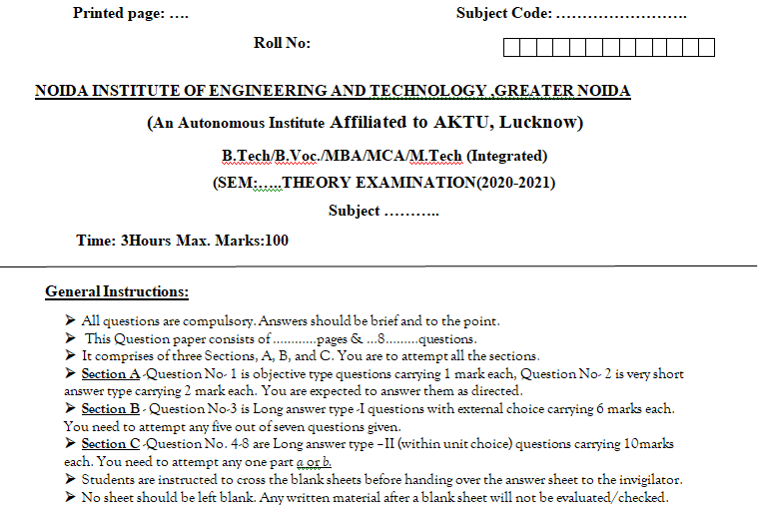
End Semester Question Paper Template

Slide 20
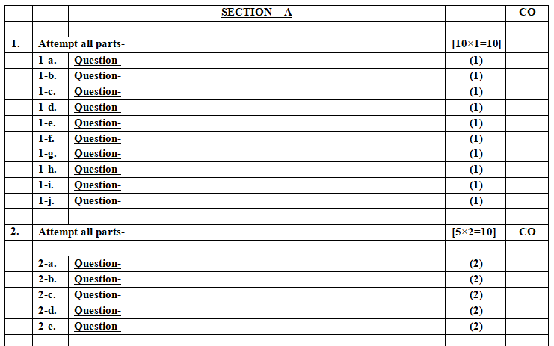
End Semester Question Paper Template

Slide 21
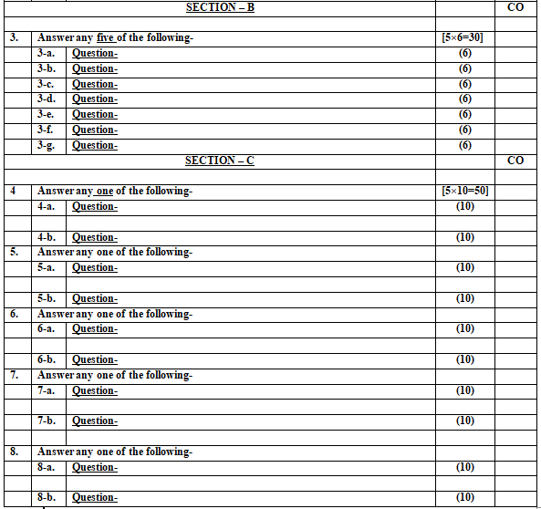
End Semester Question Paper Template

Slide 22
Brief Introduction about the Subject with videos
Introduction: Automata theory is the study of abstract machines and automata, as well as the computational problems that can be solved using them. It is a theory in theoretical computer science.
Introduction, Finite Automata, Regular Expressions | Video Lectures | Theory of Computation | Mathematics | MIT OpenCourseWare
Unit I
https://nptel.ac.in/courses/106/104/106104028/Lecture 1 -10, Lecture 16, 17 18, 19
https://nptel.ac.in/courses/113/11111/1003016/ https://www.youtube.com/results?search_query=%23AutomataTheory
Unit II
https://nptel.ac.in/courses/106/104/106104028/Lecture 11 -15
https://nptel.ac.in/courses/113/11111/1003016/ https://www.youtube.com/results?search_query=%23AutomataTheory
Unit III
https://nptel.ac.in/courses/106/104/106104028/Lecture 20 -30
https://nptel.ac.in/courses/106/106/106106049/ https://www.youtube.com/results?search_query=%23AutomataTheory
Unit IV
https://nptel.ac.in/courses/106/104/106104028/Lecture 31 -33
https://nptel.ac.in/courses/113/11111/1003016/ https://www.youtube.com/results?search_query=%23AutomataTheory
Unit V
https://nptel.ac.in/courses/106/104/106104028/Lecture 34-42
https://nptel.ac.in/courses/113/11111/1003016/ https://www.youtube.com/results?search_query=%23AutomataTheory

Slide 23
Contents
Topics | Duration (in Hours)
Pushdown Automata | 8
Properties of CFL | 3

Slide 24
Objective of Unit
Objective of the course is to make students able to:
Design a Pushdown Automata.
Differentiate between deterministic and non-deterministic PDA.
Recognize the expressive power of DPDA and NPDA.
Explain the closure properties of CFL.
Apply pumping lemma for CFL.

Slide 25
Prerequisite and Recap
CFG is used to generate context free languages.
We need an automata that can accept CFL.
Simplification of grammar includes
Reduction of grammar
Elimination of Null production
Elimination of Unit production
We can normalize a CFG in CNF and GNF.

Slide 26
Push Down Automata (CO4)
Objective of the Topic
The objective of the topic is to make the student able to:
Learn the tuples of pushdown automata
Recognize the language accepted by PDA.
Design deterministc and non-deterministic PDA
Realize the expressive power of DPDA, NPDA and two stack PDA
Convert FA to RE and vice-versa.

Slide 27
PDA for What ??
What FA is to Regular Language
PDA is to CFL

Slide 28
Why PDA ??
Finite automata accept the regular languages.
e.g. { 0^{n} | n ∈ ℕ } , { 0^{m} 1^{n} | n ∈ ℕ }
We may need unbounded memory to recognize context-free languages.
e.g. { 0^{n}1^{n} | n ∈ ℕ } requires unbounded counting.
How do we build an automaton with finitely many states but unbounded memory?
The answer is Pushdown Automata (PDA).

Slide 29
Why PDA ??
Informally a pushdown automata (PDA) is an NFA + Stack.
Input Tape
a | b | a | b | b | b | a | a | a | b
Z₀
Finite Control
Stack

Slide 30
Pushdown Automata
A pushdown automaton (PDA) is a finite automaton equipped with a stack-based memory.
Each transition
is based on the current input symbol and the top of the stack,
optionally pops the top of the stack, and
optionally pushes new symbols onto the stack.
Initially, the stack holds a special symbol Z₀ that indicates the bottom of the stack.

Slide 31
Formal Definition of PDA
PDA is a machine with 7-tuples M= (Q, Σ, Γ, δ, q₀, Z₀, F), where
Q is a finite set of states,
Σ is an alphabet,
Γ is the stack alphabet of symbols that can be pushed on to the stack,
δ : Q ×{ Σ ∪ Ɛ} × Γ → (Q × Γ*) is the transition function,
q₀ ∈ Q is the start state,
Z₀ ∈ Γ is the stack start symbol, and
F ⊆ Q is the set of accepting states.

Slide 32
Acceptance by PDA
There are two ways for acceptance by PDA
Acceptance by Final state
Acceptance by Empty stack

Slide 33
PDA
PDA for L= {a^{n}b^{n} | n > 0}.
Acceptance by Final state
δ( q₀, a, Z₀) = (q₀, aZ₀)
δ( q₀, a, a) = (q₀, aa)
δ( q₀, b, a) = (q₁, Ɛ)
δ( q₁, b, a) = (q₁, Ɛ)
δ( q₁, Ɛ, Z₀) = (q_{f}, Z₀)
a, Z₀ / a Z₀
a , a / aa
b , a / Ɛ
q0
q1
q_{f}
b , a / Ɛ
Ɛ, Z₀ / Z₀
M= {{q₀, q₁, q_{f}}, {a, b}, {a, Z₀}, δ, q_{0,} Z_{0,} q_{f}}

Slide 34
PDA
PDA for L= {a^{n}b^{n} | n > 0}.
Acceptance by Empty stack
δ( q₀, a, Z₀) = (q₀, aZ₀)
δ( q₀, a, a) = (q₀, aa)
δ( q₀, b, a) = (q₁, Ɛ)
δ( q₁, b, a) = (q₁, Ɛ)
δ( q₁, Ɛ, Z₀) = (q₁, Ɛ)
a, Z₀ / a Z₀
a , a / aa
b , a / Ɛ
Ɛ, Z₀ / Ɛ
q0
q1
b , a / Ɛ
M= {{q₀, q₁}, {a, b}, {a, Z₀}, δ, q_{0,} Z_{0,} φ}

Slide 35
PDA
PDA for L= {a^{n} c^{m} b^{n} | m, n > 0}.
δ( q₀, a, Z₀) = (q₀, aZ₀)
δ( q₀, a, a) = (q₀, aa)
δ( q₀, c, a) = (q₁, a)
δ( q₁, c, a) = (q₁, a)
δ( q₁, b, a) = (q₂, Ɛ)
δ( q₂, b, a) = (q₂, Ɛ)
δ( q₂, Ɛ, Z₀) = (q_{f}, Z₀)
a, Z₀ / a Z₀
a , a / aa
c , a / a
b , a / Ɛ
q0
q1
q2
q_{f}
c , a / a
b , a / Ɛ
Ɛ, Z₀ / Z₀
M= {{q₀, q₁, q₂,q_{f} }, {a, b, c}, {a, Z₀}, δ, q_{0,} Z_{0,} q_{f}}

Slide 36
PDA
PDA for L= {a^{n} c b^{2n} | n > 0}.
δ( q₀, a, Z₀) = (q₀, aaZ₀)
δ( q₀, a, a) = (q₀, aaa)
δ( q₀, c, a) = (q₁, a)
δ( q₁, b, a) = (q₂, Ɛ)
δ( q₂, b, a) = (q₂, Ɛ)
δ( q₂, Ɛ, Z₀) = (q_{f}, Z₀)
a, Z₀ / aa Z₀
a , a / aaa
b , a / Ɛ
q0
q1
q2
q_{f}
c , a / a
b , a / Ɛ
Ɛ, Z₀ / Z₀
M= {{q₀, q₁, q₂,q_{f} }, {a, b, c}, {a, Z₀}, δ, q_{0,} Z_{0,} q_{f}}

Slide 37
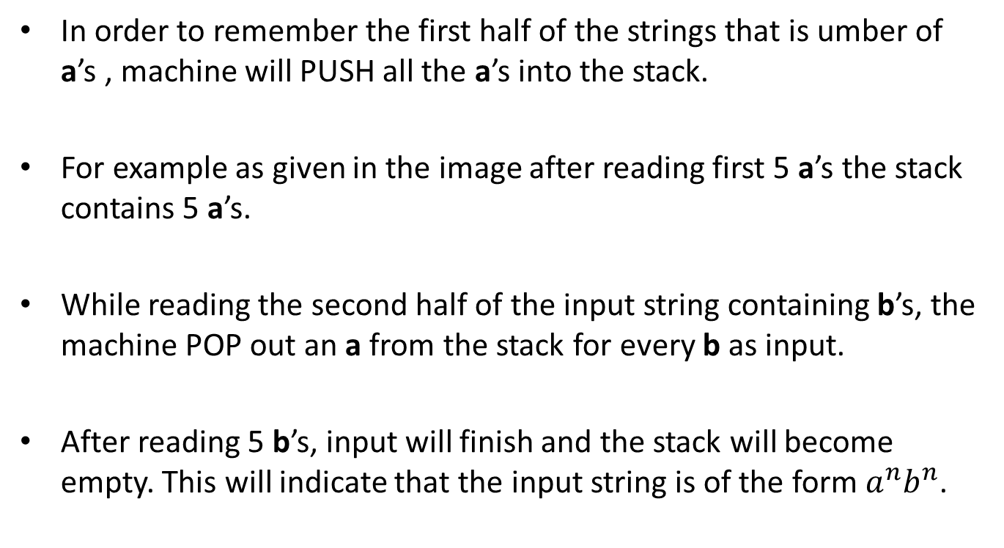
Example of PDA (CO4)
In order to remember the first half of the strings that is umber of a’s , machine will PUSH all the a’s into the stack.
For example as given in the image after reading first 5 a’s the stack contains 5 a’s.
While reading the second half of the input string containing b’s, the machine POP out an a from the stack for every b as input.
After reading 5 b’s, input will finish and the stack will become empty. This will indicate that the input string is of the form $a^{n}b^{n}$.

Slide 38
Instantaneous Description of a PDA
For a FA, the only thing of interest about the FA is its state.
For a PDA, we want to know its state and the entire content of its stack.
Often the stack is one of the most useful pieces of information, since it is not bounded in size.
We can represent the instantaneous description (ID) of a PDA by the following triple (q,w,γ):
q is the state
w is the remaining input
γ is the stack contents
By convention the top of the stack is shown at the left end of γ and the bottom at the right end.

Slide 39
Instantaneous Description of a PDA
Write down the IDs or moves for input string w = “aabb” of PDA as M = ({q₀, q₁, q₂}, {a, b}, {a, b, Z₀}, δ, q0, Z₀, {q₂}), where δ is defined by following rules:
δ(q₀, a, Z₀) = {(q₀, aZ₀)} Rule (1) δ(q₀, a, a) = {(q₀, aa)} Rule (2) δ(q₀, b, a) = {(q₁, λ)} Rule (3) δ(q₁, b, a) = {(q₁, λ)} Rule (4) δ(q₁, λ, Z₀) = {(q₂, λ)} Rule (5) δ(q₀, λ, Z₀) = {(q₂, λ)} Rule (6)
Also check string w is accepted by PDA or not?

Slide 40
Instantaneous Description of a PDA
Solution: Instantaneous Description for string w = “aabb”
(q₀, aabb, Z₀) |- (q₀, abb, aZ₀) as per Rule (1) |- (q₀, bb, aaZ₀) as per Rule (2) |- (q₁, b, aZ₀) as per Rule (3) |- (q₁, λ, Z₀) as per Rule (3) |- (q2, λ, λ) as per Rule (5)
Finally PDA reached a configuration of (q₂, λ, λ) i.e. the input tape is empty or input string w is completed, PDA stack is empty and PDA has reached a final state. So the string ‘w’ is accepted.

Slide 41
The Language of a PDA
Recap: Till now we have studied about basic concept and definition of Push Down Automata.
Prerequisite: Brief review of basic operations on stack & Augmenting stack
Objective: To understand the language accepted by PDA.

Slide 42
The Language of a PDA
Objective: To understand the language accepted by PDA.
A language of a PDA can be accepted by two ways:
Through final State
Through empty stack
It is also possible to convert between the two states:
From Final State to empty stack
From empty stack to final state

Slide 43
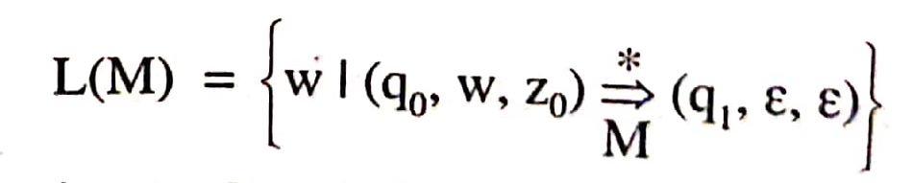
Acceptance by Empty Stack
Let the PDA , M = (Q, Σ, Γ, δ, q0, z0, Φ) then the language accepted by an empty stack is given by:
Where q1 is any state belonging to Q and the stack becomes empty on application of input string w.

Slide 44
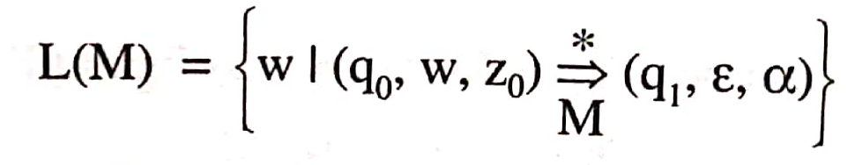
Acceptance by Final State
Let the PDA , M = (Q, Σ, Γ, δ, q0, z0, Φ) then the language accepted by M through a final state is given by:
Where state q1 ϵ F, α, the final contents of the stack are irrelevant as a string is accepted through a final state.

Slide 45
CFG = PDA CFL
Equivalence of CFG and PDA
PDA by Final state
PDA by Empty Stack
CFG

Slide 46
CFG to PDA
Let G = (V, T, P, S) be a CFG, we can construct a PDA M= { {q}, T, {V ∪ T}, δ, q, S, φ } where
Is defined as follows:
For each variable A and production A → α , add production δ (q, Ɛ, A) = (q, α)
For each terminal a, add production
δ (q, a, a) = (q, Ɛ)

Slide 47
CFG to PDA
Example: Construct PDA for given CFG
S → 0BB
B → 0S | 1S | 0
Also check whether 010⁴ is being accepted by PDA or not?
Solution: Productions:
δ (q, Ɛ, S) = (q, 0BB)
δ (q, Ɛ, B) = { (q, 0S), (q, 1S), (q, 0) }
δ (q, 0, 0) = (q, Ɛ)
δ (q, 1, 1) = (q, Ɛ)
Instantaneous Description
δ(q, 010000, S) |-- (q, 010000, 0BB)
|-- (q, 10000, BB)
|-- (q, 10000, 1SB)
|-- (q, 0000, SB)
|-- (q, 0000, 0BBB)
|-- (q, 000, BBB)
|-- (q, 000, 0BB)
|-- (q, 00, BB)
|* (q, 0, 0)
|-- (q, Ɛ)

Slide 48
PDA to CFG
If A = (Q, Σ, Γ, δ, q0, Z0, F) is a PDA then there exists a Context-free grammar G such that L(G) =N(A).

Slide 49
PDA to CFG
Construction of G.
We define G = (V, T, P, S), where
V = {S} U { [q, Z, q’] |q, q' ∈ Q, Z ∈ Γ}
The productions in P follow the rules R1 to R3:
R 1: For start symbol S
S → [qo, Z₀, q’] for every q ∈ Q.
R2: For δ(q, a, Z) = (q', ∈)
[q, Z, q’] → a
R3: For δ(q, a, Z) = (q1, Z1 Z2 …….Zm )
[q, Z, q’l → a [q1, Z1, q2][q2,Z2 , q3] ... [qm, Zm, q’]
where each of the states q', q2, .. qm' can be any state in Q.

Slide 50
PDA to CFG
Example: Construct a context-free grammar G which accepts N(A),
where A = ({qo}, {a, b}, {Z, Z₀}, δ, qo, Z₀, φ) and
δ is given by
δ(qo, a, Z₀) = (qo, ZZ₀)
δ(qo, a, Z) = (qo, ZZ)
δ(q0, b, Z) = (q0, Ɛ)
δ(qo, Ɛ, Z₀) = (qo, Ɛ)

Slide 51
PDA to CFG
Solution:
S → [q0, Z_{0,} q0]
δ(qo, a, Z₀) = (qo, ZZ₀)
[q0, Z_{0,} q0] → a [q0, Z_{0,} q0] [q0, Z_{0,} q0]
δ(qo, a, Z) = (qo, ZZ)
[q0, Z, q0] → a [q0, Z, q0] [q0, Z, q0]
δ(q0, b, Z) = (q0, Ɛ)
[q0, Z_{0,} q0] → b
δ(qo, Ɛ, Z₀) = (qo, Ɛ)
[q0, Z_{0,} q0] → Ɛ

Slide 52
PDA to CFG
Question: Construct a context-free grammar G which accepts N(A),
where A = ({q₀, q1}, {a, b}, {Z, Z₀}, δ, q₀, Z₀, φ) and
δ is given by
δ(q₀, b, Z₀) = (q₀, ZZ₀)
δ(q₀, Ɛ, Z₀) = (q₀, Ɛ)
δ(q₀, b, Z) = (q₀, ZZ)
δ(q₀, a, Z) = (q₁, Z)
δ(q₁, b, Z) = (q₁, Ɛ)
δ(q₁, a, Z₀) = (q₁, Z₀)

Slide 53
Construction of PDA from CFG
Recap: Till now we have studied about basic concept and definition of Push Down Automata with examples.
Prerequisite: Brief review of basic operations on stack & Augmenting stack and CFG.
Objective: To understand the relationship between PDA and CFG.

Slide 54
Construction of PDA from CFG: Example
Q: Find a PDA for the given grammar:
S → 0S1|00|11
Solution:
The equivalent PDA, M is given by:
M = ({q},{0,1}, {0,1,S}, δ, q, S, Φ), where δ is given by:
δ(q, ɛ, S) = {(q,0S1), (q,00), (q,11)}
δ(q, 0, 0) = {(q, ɛ)}
δ(q, 1, 1) = {(q, ɛ)}
For CFG to PDA follow the following link:
https://www.youtube.com/watch?v=J_6JJH34XyQ

Slide 55
Non-deterministic Pushdown Automata
Recap: Till now we have studied about basic concept and definition of Push Down Automata with examples and relationship between CFG and PDA.
Prerequisite: Brief review of basic operations on stack & Augmenting stack and CFG.
Objective: To understand the designing of Non Deterministic PDA.

Slide 56
Non-deterministic Pushdown Automata
Objective: To understand the designing of Non Deterministic PDA.
The non-deterministic pushdown automata is very much similar to NFA.
The CFG which accepts deterministic PDA accepts non-deterministic PDAs as well. Similarly, there are some CFGs which can be accepted only by NPDA and not by DPDA. Thus NPDA is more powerful than DPDA.

Slide 57
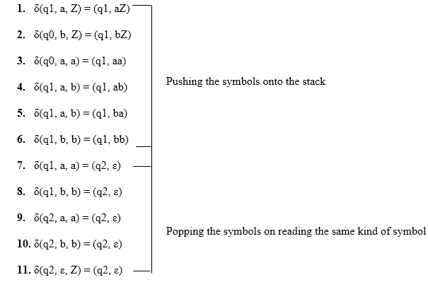
Non-deterministic Pushdown Automata
Design PDA for Palindrome strips.

Slide 58
Non-deterministic PDA
Power ??
P (NFA) = P (DFA)
P (NPDA) ≥ P (DPDA)
NPDA
DPDA
Finite Automata

Slide 59
Non-deterministic PDA
Construct a PDA for L = {ww^{R} | w ∈ (0, 1) }.
0, Z₀ / 0 Z₀
0, Z₀ / 0 Z₀
0 , 0 / 00
0, 1 / 01
1, 0 / 10
1, 1 / 11
Why It is
Non-deterministic ??
Why not
deterministic ??
0 , 0 / Ɛ
1, 1 / Ɛ
q0
q1
q_{f}
Ɛ , Z₀ / Z₀
Ɛ, 0 / 0
Ɛ, 1 / 1
Ɛ, Z₀ / Z₀

Slide 60
Deterministic PDA
Construct a PDA for L = {wcw^{R} | w ∈ (0, 1) }.
0, Z₀ / 0 Z₀
0, Z₀ / 0 Z₀
0 , 0 / 00
0, 1 / 01
1, 0 / 10
1, 1 / 11
0 , 0 / Ɛ
1, 1 / Ɛ
q0
q1
q_{f}
c , Z₀ / Z₀
c, 0 / 0
c, 1 / 1
Ɛ, Z₀ / Z₀

Slide 61
Difference between DPDA and NPDA
DPDA | NPDA
In NPDA, there may exits exactly one transition for each input symbol. | In PDA, there may exits more than one transition for each input symbol
Table contains single entities | Table may contains multiple defined entities.
Less powerful than NPDA. | More powerful than DPDA.
Ex: PDA for L= {wcw^{R} |w∈(0, 1)*} | Ex: PDA for L= {ww^{R} |w∈(0, 1)*}

Slide 62
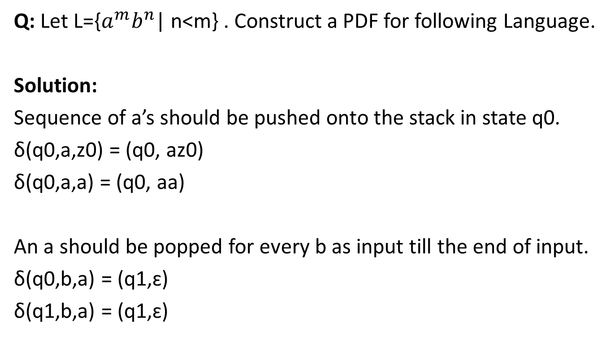
PDA Examples with Solutions
Q: Let L={$a^{m}b^{n}$| n<m} . Construct a PDF for following Language.
Solution:
Sequence of a’s should be pushed onto the stack in state q0.
δ(q0,a,z0) = (q0, az0)
δ(q0,a,a) = (q0, aa)
An a should be popped for every b as input till the end of input.
δ(q0,b,a) = (q1,ɛ)
δ(q1,b,a) = (q1,ɛ)

Slide 63
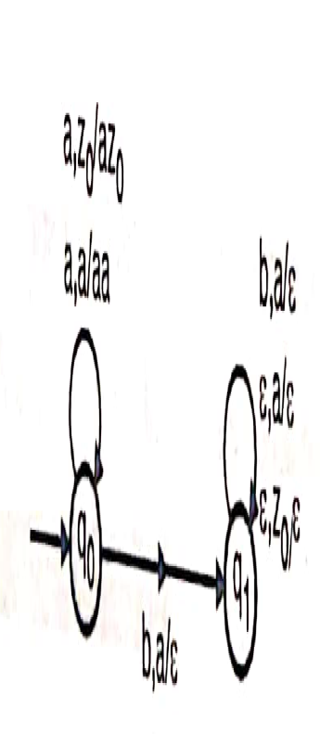
PDA Examples with Solutions
Additional m-n a’s should be popped from the stack.
δ(q1, ɛ, a) = (q1, ɛ)
Finally the symbol z0 should be popped out to make the state empty.
δ(q1, ɛ, z0) = (q1, ɛ)

Slide 64
PDA Examples with Solutions
Q: Design a PDA for accepting the set of all strings over an alphabet {a,b} with an equal number of a’s and b’s.
Solution:
Stack will be used to store excess of a’s over b’s or excess of b’s over a’s out of input seen so far.

Slide 65
PDA Examples with Solutions
1. Stack contains z0 (topmost symbols) and the input is a:
δ(q0, a, z0) = (qo, az0)
2. Stack contains z0 and the input is b:
δ(q0, b, z0) = (qo, bz0)
3. Stack contains a and the input is a.
δ(q0, a, a) = (qo, aa)
4. Stack contains a and the input is b
δ(q0, a, b) = (qo, ɛ )
5. Stack contains b and the input is a
δ(q0, b, a) = (qo, ɛ )
6. Stack contains b and the input is b
δ(q0, b, b) = (qo, bb )

Slide 66
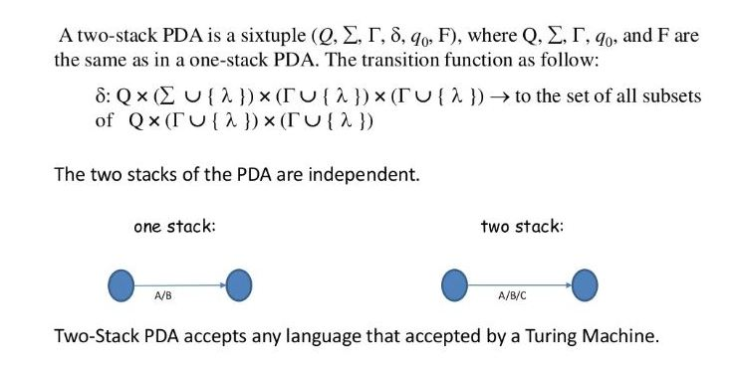
Two stack PDA

Slide 67
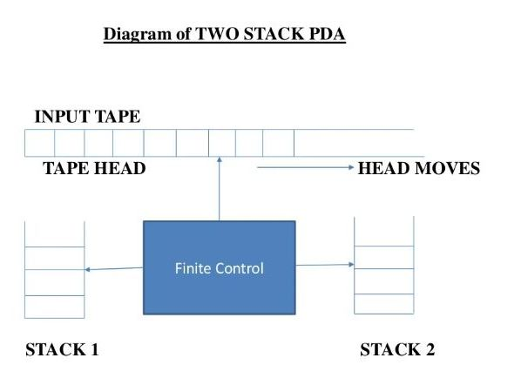
Two stack PDA

Slide 68
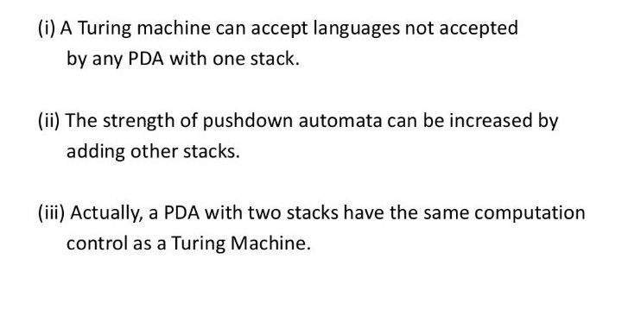
Two stack PDA

Slide 69
Two stack PDA
A two stack PDA is deterministic.
Two stack PDA is more powerful than PDA.
Its power is equal to that of A Turing machine.
It can Perform PUSH / POP operation on either or both of the stacks.

Slide 70
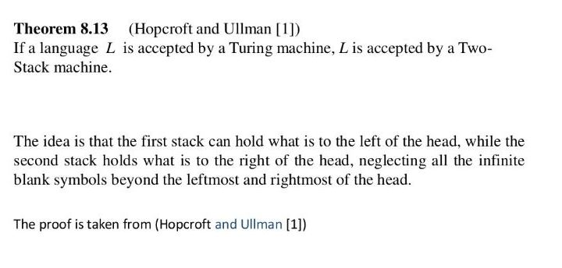
Two stack PDA

Slide 71
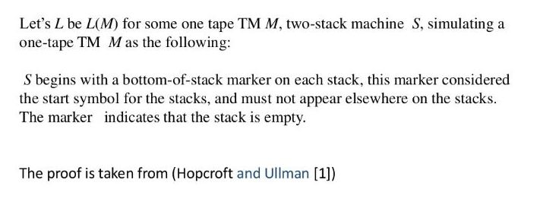
Two stack PDA

Slide 72
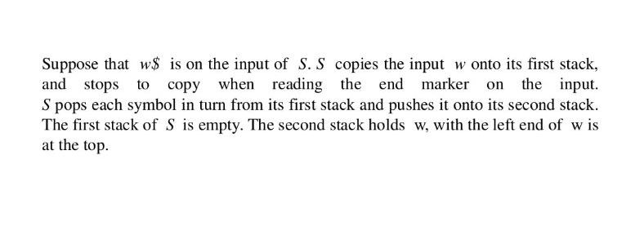
Two stack PDA

Slide 73
Recap
We learnt:
Nondeterministic Pushdown Automata (NPDA),
Deterministic Pushdown Automata(DPDA)
Pushdown Automata for Context Free Languages,
Context Free grammars for Pushdown Automata,
Two stack Pushdown Automata,

Slide 74
Properties of a Context Free Languages
Objective of the Topic
The objective of the topic is to make the student able to:
Apply pumping lemma.
Prove that a language is not context free.
Explain the closure properties of a CFL.
Apply the decision algorithm on CFL.

Slide 75
Push Down Automata
Topic mapping with Course Outcome
Topic | CO1 | CO2 | CO3 | CO4 | CO5
Properties of Context Free Languages | - | - | - | 3 | -

Slide 76
Pumping Lemma for CFL
Pumping Lemma is used to prove that a language is not CFL.
Lemma:
Let L be a CFL. Then there exists an integer constant n, such that for all w ∈ L with |w| ≥ n, then w can be rewritten as w = uvwxy, such that following conditions must be true.
(1) |vwx| ≤ n
(2) vx ≠ Ɛ
(3) for all i ≥ 0: uv^{i}wx^{i}y ∈ L

Slide 77
Pumping Lemma for CFL
Example:
Prove that L = {a^{n}b^{n}c^{n} | n > 0} is not context free.
Proof:
for every m
there is w = a^{m}b^{m}c^{m} (at least m symbols)
no matter how the pumping lemma splits w into uvwxy (|vwx| ≤ m, |vx| ≥ 1)
uv²wx²y ∉L (but why?)

Slide 78
Pumping Lemma for CFL
Case 1: v or x contains two kinds of symbols
a a a a b b b b c c c c
Then uv²wx²y ∉ L because the pattern is wrong.
Case 2: v and x both contain one kind of symbol
a a a a b b b b c c c c
Then uv²wx²y does not have the same number of a’s, b’s and c’s Conclusion: uv²wx²y ∉ L .
v
x
v
x

Slide 79
Closure Properties of CFL
CFL’s are closed under
Union
Concatenation
Kleene closure
Reversal
Homomorphisms
inverse homomorphisms
But not under intersection, complement or difference.

Slide 80
Closure Properties of CFL
Union
If L1 and L2 are CFL then L1 ∪ L2 is also CFL.
For context-free languages L1, L2 with
context-free grammars G1 and G2 and
start variables S1, S2.
The Grammar of L1 ∪ L2 will have a new start variable S and a new production S → S1 | S2

Slide 81
Closure Properties of CFL
Concatenation
If L1 and L2 are CFL then L1.L2 is also CFL.
For context-free languages L1, L2 with
context-free grammars G1 and G2 and
start variables S1, S2.
The Grammar of L1.L2 will have a new start variable S and a new production S → S1S2

Slide 82
Closure Properties of CFL
Kleene Closure
If L is CFL then L* is also a CFL.
For context-free languages with
context-free grammars G
start variables S.
The Grammar of L* will have a new start variable S1 and a new production S1 → SS1 | Ɛ

Slide 83
Closure Properties of CFL
UNION of a Context Free Language and
Regular Language is
Context Free Language.
Intersection of a Context Free Language and
Regular Language is
Context Free Language.

Slide 84
Decision Properties of CFL
Decision Algorithms are used to determine the following properties of a CFL.
Emptiness
Finiteness
Membership.

Slide 85
Decision Properties of CFL
Emptiness
For context Free grammar G, find if L(G) = φ.
Algorithm:
1.Remove useless variables
2.Check if start variable S is useless.

Slide 86
Decision Properties of CFL
Finiteness
For context Free grammar G, find if L(G) is finite.
Algorithm:
Remove useless symbols.
Remove unit and Ɛ productions.
Create dependency graph for variables.
If there is a loop in the dependency graph then the language is infinite.

Slide 87
Decision Properties of CFL
Membership
For context Free grammar G, find if w ∈ L(G).
Algorithm:
Exhaustive search parser
CYK parsing algorithm

Slide 88
Video Links
Self Made Video Link:
https://www.youtube.com/playlist?list=PLKhyqvN-JcP5AF4UzRz9wxFVBm63igm7y
NPTEL Video Links
https://youtu.be/7ZbDEfnYwAo
https://youtu.be/_3Fi5jBhinE
https://youtu.be/q82IcIjS1y8

Slide 89
Daily Quiz
Which of the following automata takes stack as auxiliary storage? A. Finite automata B. Push down automata C. Turing machine D. All of the mentioned
A push down automata can be represented as: PDA= ε-NFA +[stack] State true or false: A. true B. false
A PDA machine configuration (p, w, y) can be correctly represented as: A. (current state, unprocessed input, stack content) B. (unprocessed input, stack content, current state) C. (current state, stack content, unprocessed input) D. none of the mentioned

Slide 90
Daily Quiz
Push down automata accepts _________ languages. A. Type 3 B. Type 2 C. Type 1 D. Type 0
A string is accepted by a PDA when A. Stack is empty B. Acceptance state C. Both A and B. D. None of the mentioned

Slide 91
Daily Quiz
If the PDA does not stop on an accepting state and the stack is not empty, the string is: A. rejected B. goes into loop forever C. both A and B. D. none of the mentioned
A language accepted by Deterministic Push down automata is closed under which of the following? A. Complement B. Union C. Both (A. and (B. D. None of the mentioned

Slide 92
Daily Quiz
A language is accepted by a push down automata if it is: A. regular B. context free C. both (A. and (B. D. none of the mentioned
What you can say about following statement. Statement: The operations of PDA never work on elements, other than the top.
A. True
B. False
C. may be
D. can’t say

Slide 93
Weekly Assignment
Construct DPDA and NPDA for L= a^{n}b^{n}, n>=1. [C04]
Design a DPDA by using acceptance by Final state for L= wCw^{R}, w Є {a/b)⁺. [C04]
Design DPDA for L= a^{n}b^{m}c^{m}d^{n}, m, n>=1 [C04]
Design DPDA for L= a^{n}b^{m}a^{n}, m, n>=0 [C04]
NPDA for ww^{R}, w Є {0/1)*, using acceptance by Null store. [C04]
Construct DPDA to accept L={x: x Є (a/b)*where n_{a}(x) > n_{b} (x)} [C04]
Construct PDA to accept L={w: w Є (a/b)*where n_{a}(w) = n_{b} (w)} [C04]
Design a DPDA to accept L= { a^{m}b^{m}c^{n} : m, n>=1} [C04]
Design a PDA which can detect both even and odd palindrome. [C04]
Convert the following CFG into PDA: S→0S1/A, A→1A0/S/ε [C04]

Slide 94
Weekly Assignment
Design PDA for the following languages [C04]
L=a^{m}b^{n} i) n>m ii) m>n
L={ a^{n}b^{n}c^{m}d^{m}, m,n>=0}
L={a^{2n}bc where n>=0}
L={(ab)^{n} where n>=1}
L={a^{n}bc^{2n} where n>=1}
L=(a^{n+1}b^{2n} where n>=0}
L={a^{n}b^{m}c^{m-n} where n>=0, m>=0, m>=n}
L={a^{n}b^{m}a^{n} where m,n>=1}U {a^{n}c^{n} where n>=1}

Slide 95
MCQ s
Consider the languages:
L1 = {wwR |w ∈ {0, 1}*}
L2 = {w#wR | w ∈ {0, 1}*}, where # is a special symbol
L3 = {ww | w ∈ (0, 1}*)
Which one of the following is TRUE?
L1 is a deterministic CFL
L2 is a deterministic CFL
L3 is a CFL, but not a deterministic CFL
L3 is a deterministic CFL

Slide 96
MCQ s
A context free grammar can be recognized by
Push down automata
2 way linearly bounded automata
both a and b
None of the mentioned
PDA is more powerful than
A. Turing machine
B. Finite automata
C. Both (A. and (B.
D. None of these

Slide 97
MCQ s
Which of the following statement is false?
Let L is a language accepted by a PDA P then there exist a CFG G L such that L(G) =N(P)
If L is a CFL then there exists a push down automata P accepting CFL L by empty stack i.e. L = N(P)
If L is a language accepted by PDA A by final state there exist a PDA B that accepts L by empty stack such that L =L(A) = N(B).
All of these
Which of the following are decision properties? A. Emptiness B. Infiniteness C. Membership D. All of the mentioned

Slide 98
MCQ s
A CFG is not closed under A. Dot operation B. Union Operation C. Concatenation D. Iteration
A class of language that is closed under
A. union and complementation has to be closed under intersection
B. intersection and complement has to be closed under union
C. union and intersection has to be closed under complementation
D. both (A. and (B.

Slide 99
Old Question Papers
https://drive.google.com/drive/folders/19Eia3VHCl3627foiH6V_j-p4X9ZkyyC7?usp=sharing

Slide 100
Expected Questions for University Exam
Describe the instantaneous description of a PDA.
State the pumping lemma for the context free languages.
Explain Two Stacks PDA.
Is context free language closed under union? If yes, give an example.
Design a PDA which accepts set of balanced paranthesis ( { { } } ).
Construct PDA for the language L = {a^{2n}cb^{n} | n≥1}
Convert the grammar S→ aAA, A →aS | bS | a to a PDA that accepts the same language by empty stack.
Construct a PDA from the following CFG.
G = ({S, X}, {a, b}, P, S) where the productions are −
S → XS | ε , X → aXb | Xb | ab

Slide 101
Summary
PDA is an automata that accepts CFL.
CFL is generated by CFG.
A CFL is closed under: Union, concatenation, Kleene Closure and Reversal.
A CFL is not closed under Intersection, Complement and Difference.
Pumping lemma, here, is used to prove that a language is not CFL.
Decision properties: Membership, Finiteness, Emptiness.
NPDA is more powerful than DPDA.
The power of two stack PDA is same as that of Turing machine.

Slide 102
References
Hopcroft, J. E., Motwani, R., & Ullman, J. D. (2001). Introduction to automata theory, languages, and computation. Acm Sigact News, 32(1), 60-65.
Linz, P. (2006). An introduction to formal languages and automata. Jones & Bartlett Learning.
Mishra, K. L. P., & Chandrasekaran, N. (2006). Theory of Computer Science: Automata, Languages and Computation. PHI Learning Pvt. Ltd..

Slide 103
Thank You

